Slide 1
Bug Tracking System
team Members:- mohammad Nowmaan, Kshitij Srivastava, Adhithya Varshan M K, Bhaskara Jaya Sai Swaroop, Bairi poojitha, chakali pravalika, bhavna budireddi, Karumudi sravya reddy, sai Vardhani kotaru

Slide 2
Problem statement
Inefficient Issue Management and Quality Assurance in Software Development
In modern software development, maintaining high-quality applications is paramount. However, our current processes for identifying, tracking, and resolving software issues, including bugs, defects, enhancements, and feature requests, are inadequate. This leads to reduced software quality, missed deadlines, and inefficient development and testing teams.

Slide 3
Objectives
Develop a comprehensive Bug Tracking System that streamlines the issue management process.
Enable efficient issue reporting and tracking, eliminating manual and error-prone methods.
Facilitate collaboration among teams through a centralized platform.
Enable access management for security

Slide 4
Proposed Solution
A Bug Tracking System (BTS) is a crucial component of software development and quality assurance processes. It helps teams identify & report bugs, prioritize & track tasks and resolve issues or bugs in software applications
Primary objectives of any Bug Tracking System are:-
Issue Management: Efficiently track and manage software issues, including bugs, defects, enhancements, and new feature requests.
Improved Collaboration: Facilitate collaboration among development, testing, and product management teams to ensure effective bug resolution.
Quality Assurance: Enhance the overall software quality by systematically identifying and addressing issues.
Reporting and Analytics: Provide insights into the health of the software through reporting and analytics on issue trends, resolution times, and more.

Slide 5
Technical Details
The following project of Bug Tracking system has been developed using :-
Front end:-
HTML
CSS
JAVA SCRIPT
Back end:-
JAVA

Slide 6
Architectural flow
The first contact of the user to the system will be through the Main page, where the user will decide either he has to register himself to access or if he’s already registered he can directly login.
Registration page accepts the user inputs like username password email id etc, to be stored in the database and used for validation during the access management process.
Login page validates the user input to the database to allow to enter into the system. The login page further divides the access of different users to enter into their respective dashboards of tester, manager and developer.
The functionalities of each tester, manager and developers are different and role specific, so their roles and duties are customized in their dashboards.
The manager can create a new project, view a existing project, assign and close bugs

Slide 7
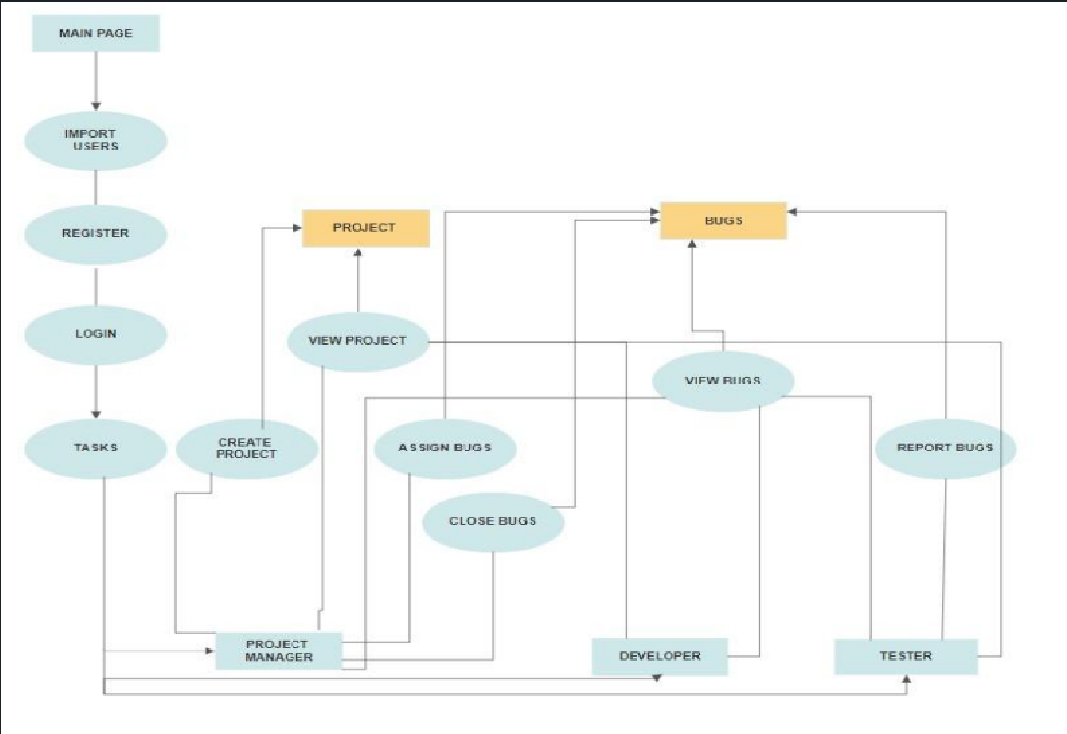
Flow diagram

Slide 8
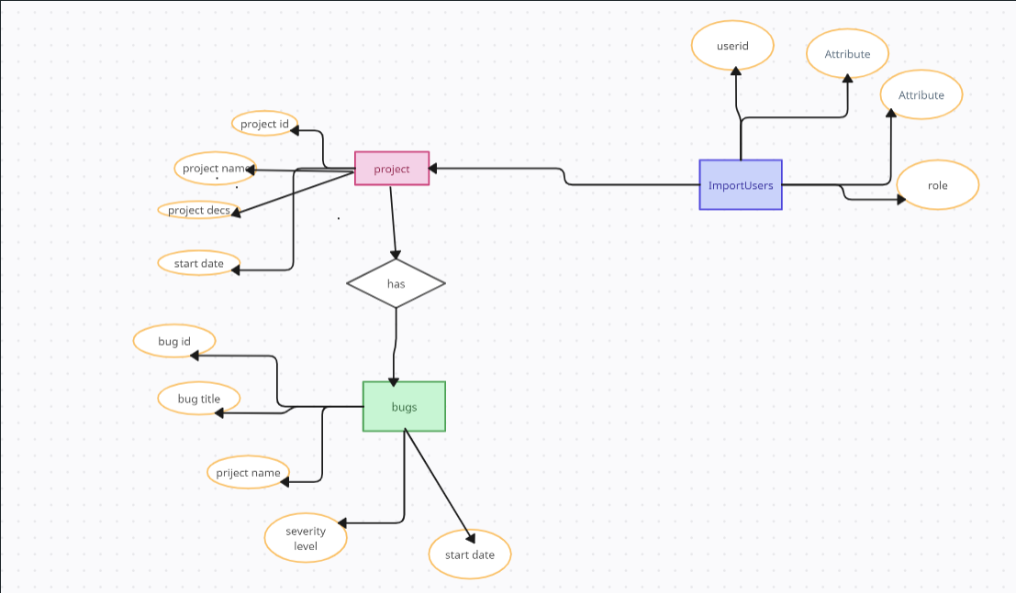
ER diagram

Slide 9
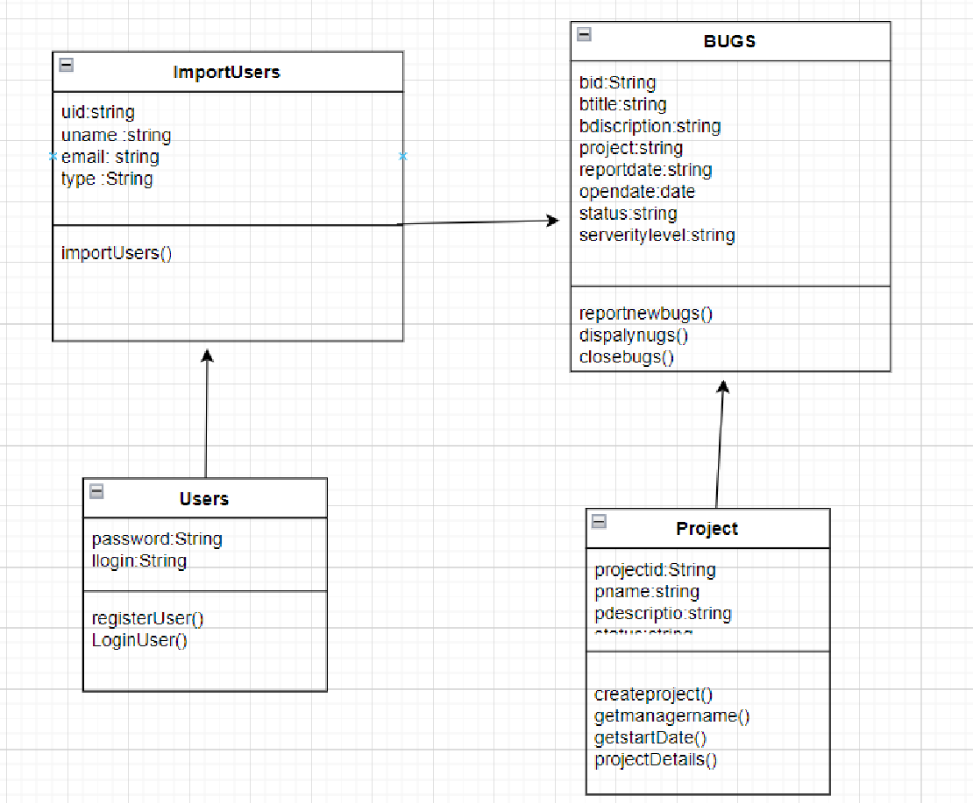
Class diagram

Slide 10
MODULES
Import Users
This module provides a form to import a file containing user information into the system
Registration
This module allows a user that has been imported to register with the system and generate a password
Login
This module allows a user to login who has been registered.

Slide 11
MODULES
Project Manager
Create a new project and manages the projects
Assign team members to a project
Views all the bugs and assigns the bugs to the developers and closes the bugs
Tester
Views the list of projects
Views the list the bugs assigned to each project by the project manager
Reports a new bug
Developer
Views the details of the project which is assigned
Mark a bug for closing

Slide 12
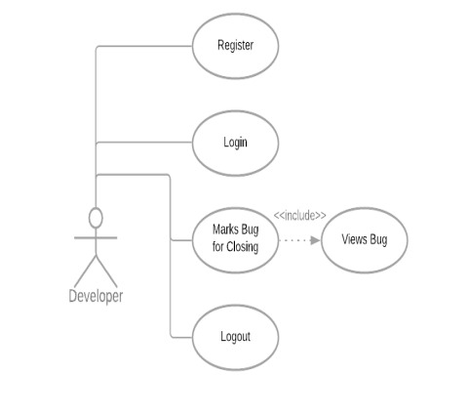

Slide 13
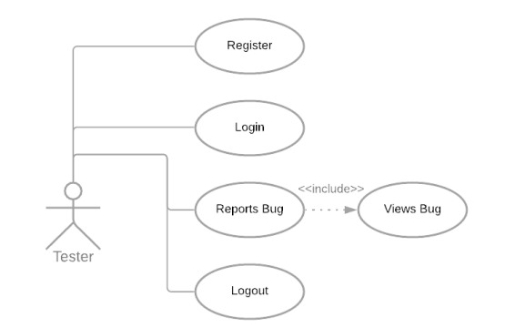

Slide 14
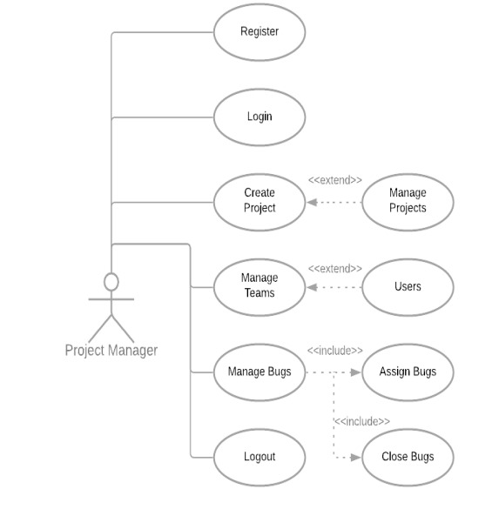

Slide 15
FUTURE SCOPE
In the future, we will move from the current prototype of the interactive system to a full-scale system that can deal with a variety of information to gather, as commonly observed in the real world.
Current bug tracking systems do not effectively elicit all of the information needed by developers. Without this information developers cannot resolve bugs in a timely fashion and so we believe that improvement to the way bug tracking systems collect information are needed.

Slide 16
CONCLUSION
A software bug occurs when an application or program doesn’t work the way it is designed to function. Most errors are faults or mistakes made by system architects, designers or developers. Testing teams use bug tracking to monitor and report on errors that occur as an application is developed and tested. The proposed Bug Tracking system is a great application with software development needs. By using the Bug Tracking Software one can eliminate bugs in their project effectively as it contains all the necessary information required by the developers to resolve the issue. This application will definitely increase communication between the team members and improve customer satisfaction and efficiency.

Slide 17
REFERENCES
https://www.google.com/
https://stackoverflow.com/
https://www.w3schools.com/java/
https://www.geeksforgeeks.org/java/

Slide 18


